Slide 1
CAPSTONE PROJECT
AI-DRIVEN PLAGIARISM INTELLIGENCE FOR ASSIGNMENTS
Presented By:
Student name : Shivangi Singh
College Name & Department : Lovely Professional University &
CSE department

Slide 2
OUTLINE
Problem Statement
Technology used
Wow factor
End users
Result
Conclusion
Git-hub Link
Future scope
IBM Certifications

Slide 3
PROBLEM STATEMENT
In today’s fast-paced digital world, plagiarism hides behind clever rephrasing. Manual checks are time-consuming, unreliable, and inefficient. Ensuring content originality is a growing challenge for students and educators alike.
Proposed Solution:
An AI-powered system built using IBM Cloud and Granite NLP models. It detects paraphrased and semantic plagiarism with high accuracy.
Designed to save time, ensure originality, and support academic
integrity.

Slide 4
TECHNOLOGY USED
IBM cloud lite services
Natural Language Processing (NLP) IBM Granite model

Slide 5
IBM CLOUD SERVICES USED
IBM Cloud Watsonx AI Studio
IBM Cloud Watsonx AI runtime
IBM Cloud Agent Lab
IBM Granite foundation model

Slide 6
WOW FACTORS
This AI agent will drastically reduce content verification time, enhance the accuracy of plagiarism detection, assist students and educators in maintaining academic integrity, and promote ethical writing practices by making similarity analysis fast, transparent, and insightful.
Unique features:
Compares input against web content, academic databases, and user-uploaded files for
comprehensive detection.
Goes beyond exact matches by identifying paraphrased and restructured content using NLP techniques.
Highlights matched content, shows source links, and provides similarity percentages for
easy review.
Accepts PDFs, DOCX, TXT, and HTML formats, with extraction and analysis done seamlessly. Tracks repeated issues over time and alerts users about high-risk submissions or common sources of duplication.

Slide 7
END USERS
Students
Teachers and Professors
Researchers
Academic Institutions and publishing houses
Content writers and journalists

Slide 8
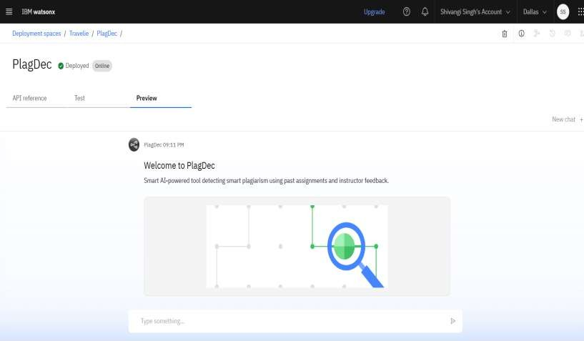
RESULTS
Deployed AI Agent

Slide 9
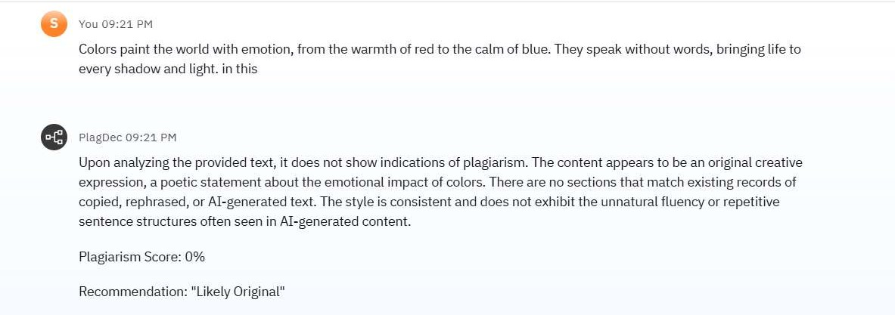
RESULTS

Slide 10
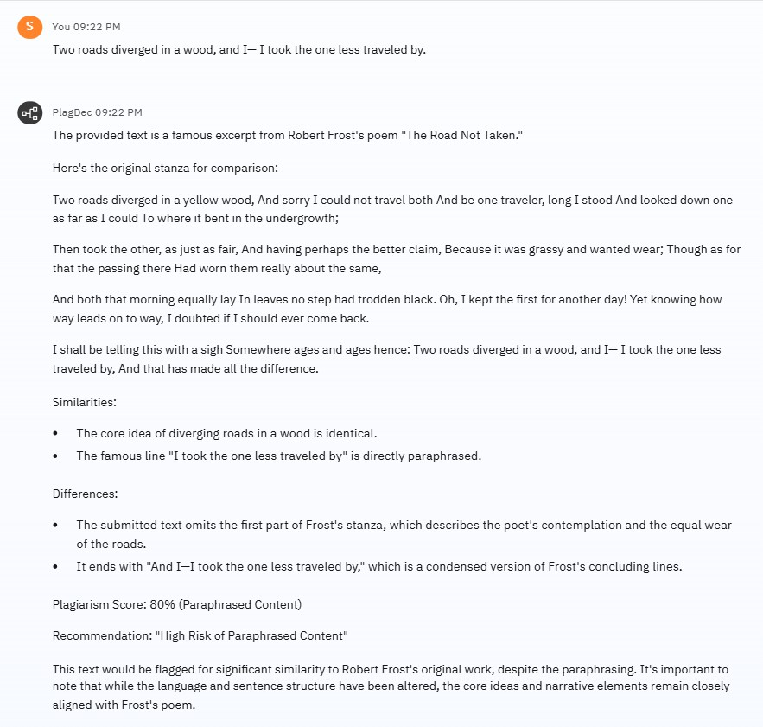
RESULTS

Slide 11
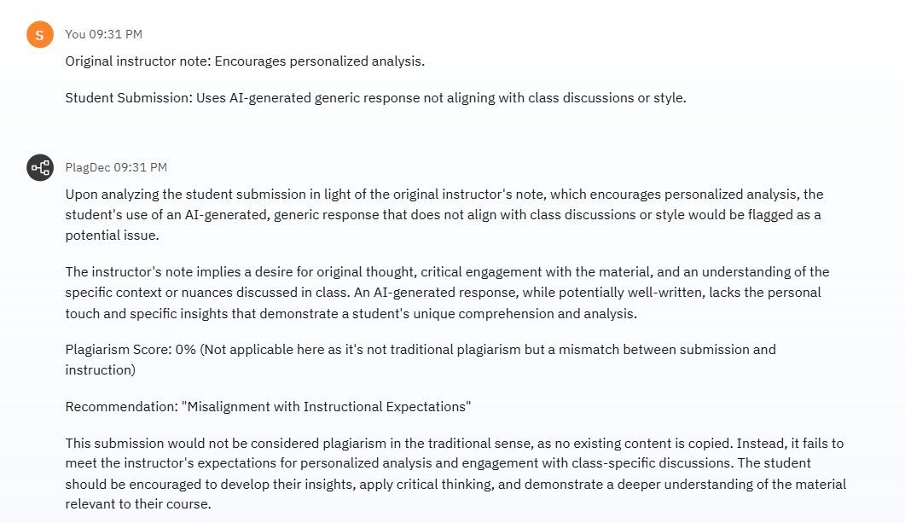
RESULTS

Slide 12
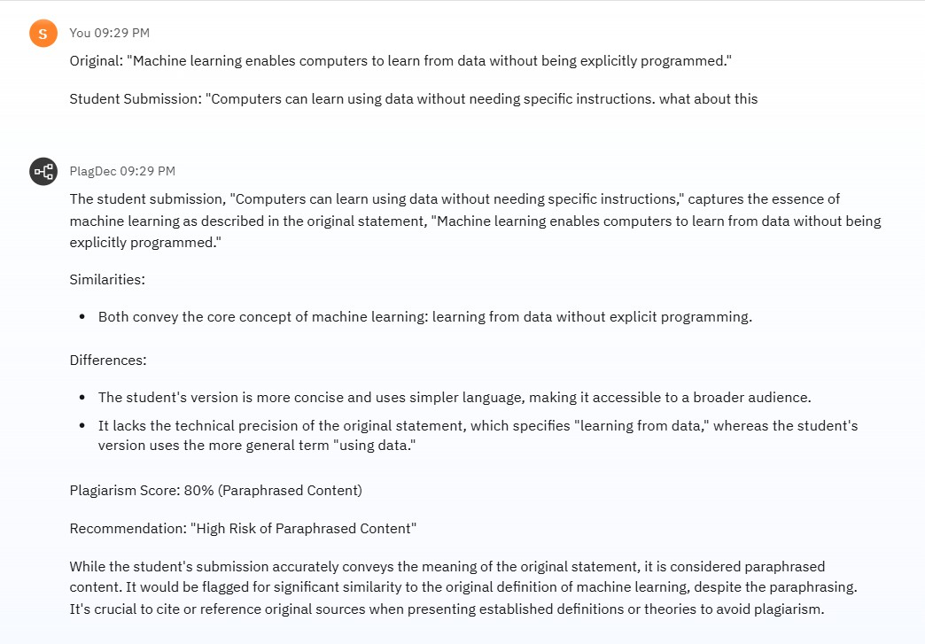
RESULTS

Slide 13
CONCLUSION
Ensures content originality with fast and accurate plagiarism detection.
Supports ethical practices in academic, professional, and creative writing.
Promotes trust, learning, and authenticity using advanced AI and NLP techniques.

Slide 14
GITHUB LINK
https://github.com/ShivangiSingh13/IBM-watsonx-PlagDec

Slide 15
FUTURE SCOPE
Multilingual Research Support
Voice-Activated Research Assistant
Real-Time Collaboration Features
Research Gap and Novel Topic Identification
Integration with Publishing Platforms
AI-Assisted Paper Drafting

Slide 16
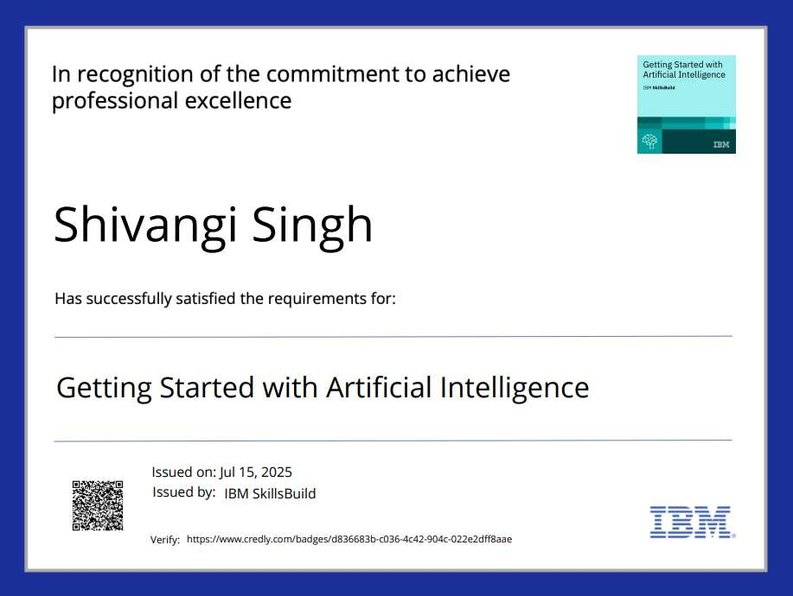
IBM CERTIFICATIONS

Slide 17
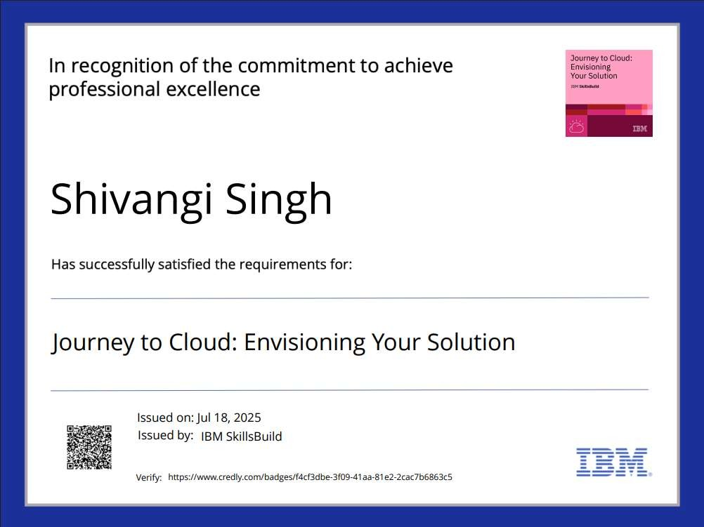
IBM CERTIFICATIONS

Slide 18
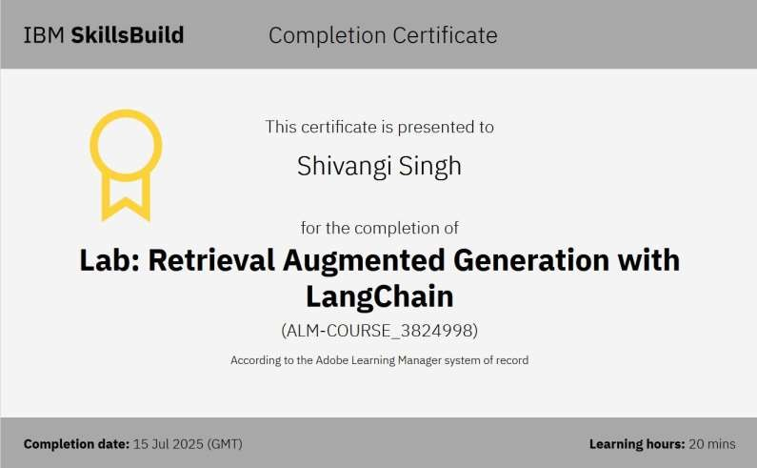
IBM CERTIFICATIONS

Slide 19
THANK YOU

